Slide 1
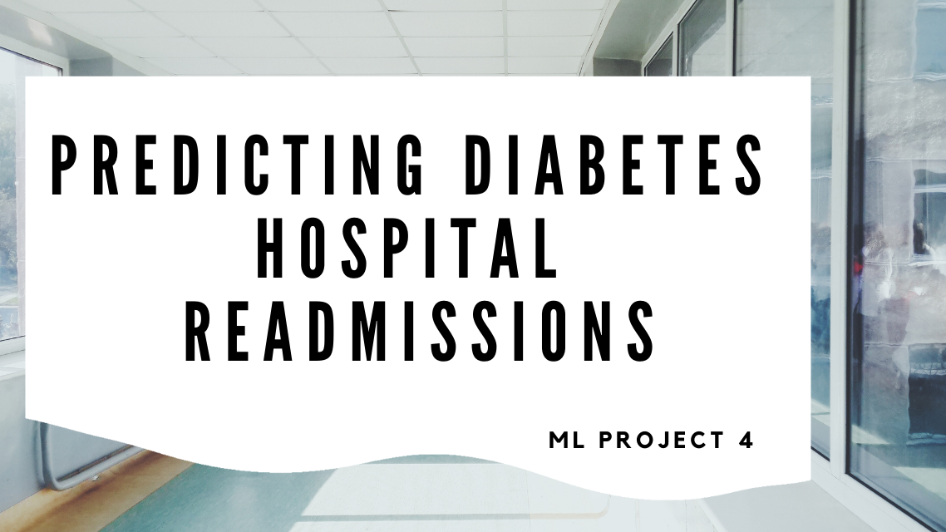
Notes:
Grey - Our project is on predicting hospital readmissions from diabetes complications. The cost of hospital readmission accounts for a large portion of hospital inpatient services spending. Diabetes is not only one of the top ten leading causes of death in the world, but also the most expensive chronic disease in the United States.

Slide 2
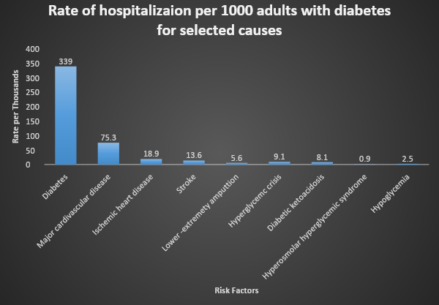
Hospitalization from Diabetes
Notes:
Grey - In 2020 34.2 million Americans, 10.5% of the US population had diabetes. Hospitalized patients with diabetes are at higher risk of readmission than those without diabetes. American hospitals spend over $41 billion on diabetic patients who are readmitted within 30 days of discharge. Being able to determine factors that lead to higher readmission in such patients, and predicting which patients will get readmitted can help hospitals save millions of dollars while improving quality of care. Therefore, reducing readmission rates for diabetic patients has great potential to reduce medical cost.

Slide 3




Meet The Team
Michelle Davis
Yingying Li
Lauren To
Grey Hardy
Notes:
Grey - our team members are Michelle Davis, Yingying Li, Lauren To, and myself Grey Hardy.

Slide 4

Introduction
Project Overview
Technologies/Data Source
EDA / Preprocessing
Modeling
Website
Q&A
Notes:
Grey - Next you will hear our project overview, hear about our technologies and data sources used. We’ll go over our development process, present our website and provide an opportunity for questions.

Slide 5
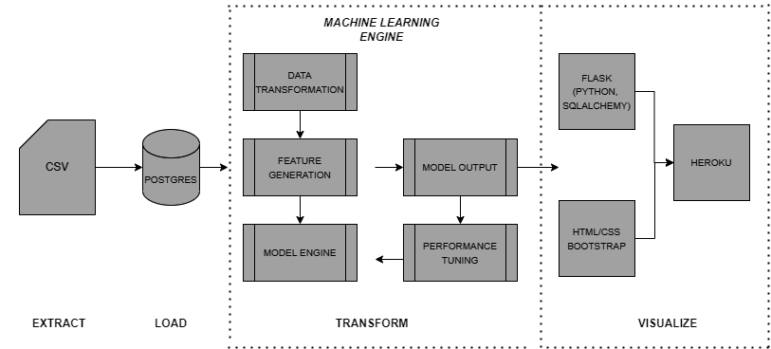
Project Overview
Notes:
Grey - Extracted > Cleaned Data > Loaded into Postgres > Created, evaluated, and optimized our Machine model, then we visualizing of our final application is provided by Heroku.

Slide 6
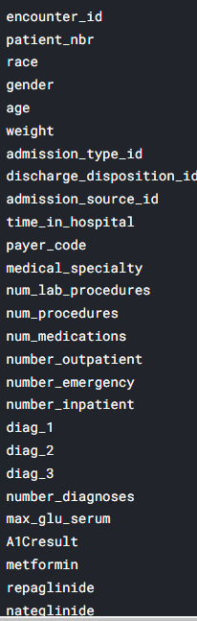
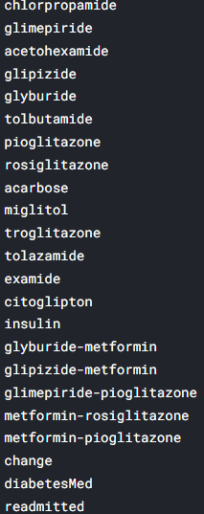
EDA
Final Features
Number of Medications
Time in Hospital
Age
Number of Procedures
Race
Gender
Reduced
6
50
Notes:
Michelle - A little about our data. The data is from 130 Us Hospital for years 1999-2008. The dataset contained 102k rows and 50 features.
Since we are primarily interested in factors that lead to early readmission, we defined the readmission attribute (outcome) as having two values: “readmitted,” if the patient was readmitted within 30 days of discharge or “otherwise,” which covers both readmission after 30 days and no readmission at all.
For EDA we wanted to answer these questions:
What factors are the strongest predictors of hospital readmission in diabetic patients? Then How well can we predict hospital readmission in this dataset with limited features?
A limitation was that data was last updated in 2008

Slide 7
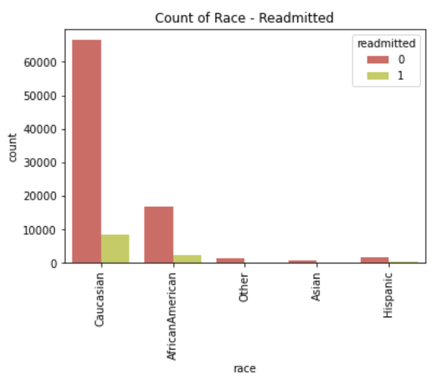
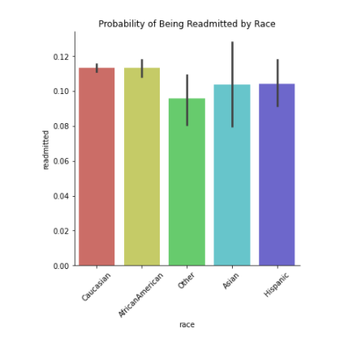
EDA
FEATURE COUNT
FEATURE DISTRIBUTION
Notes:
Michelle - We looked at the distribution of each of our 6 features. Here is one example on Race. From the first graph, it is clear that there are a higher population of Caucausian diabetic encounters. However when we look at the rate of admissions for African Americans for example, we have the same probability of hospital readmittance. This shows that there could be higher readmittance for African Americans per 1000 encounters than Caucasian.
We looked at the counts and distribution for each of our six features.

Slide 8
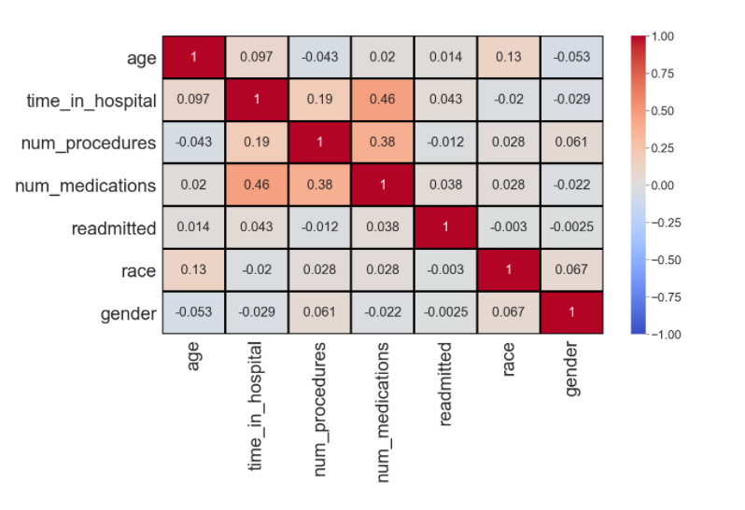
EDA
CORRELATION MATRIX
Notes:
Michelle - Understanding the relationship between attributes in our dataset.
In addition to looking at each feature, we also looked to see if there is correlation between features in our dataset. If there is strong correlation between any features in our dataset, the model could be impacted by multicollinearity which can lead to misleading results. If features are strongly correlated, we will need to eliminate them from our model.
Since no features are strongly correlated in our matrix (above .5), we can move ahead with existing features.

Slide 9
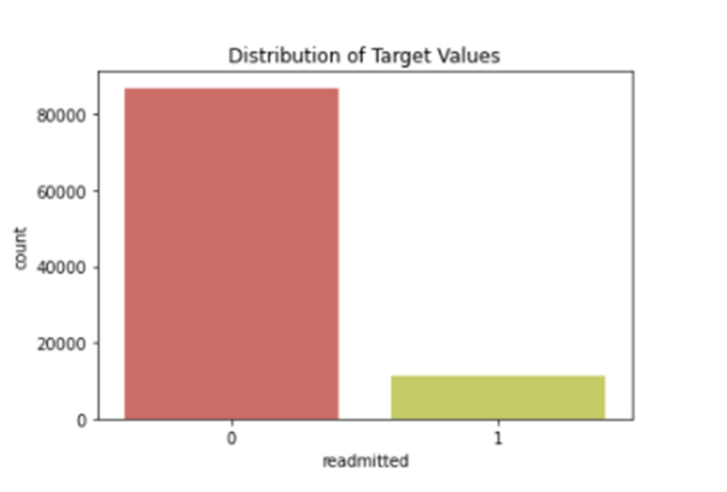
EDA
TARGET DISTRIBUTION
0 – not readmitted early 1 – early readmission
Notes:
Michelle - For our target variables. With 0 being the patient was not readmitted early. While 1 is for early readmission. As you can see, there are far more of Class 0 than Class 1, which means that our model may have some imbalance. We will discuss how we address this imbalance later.

Slide 10
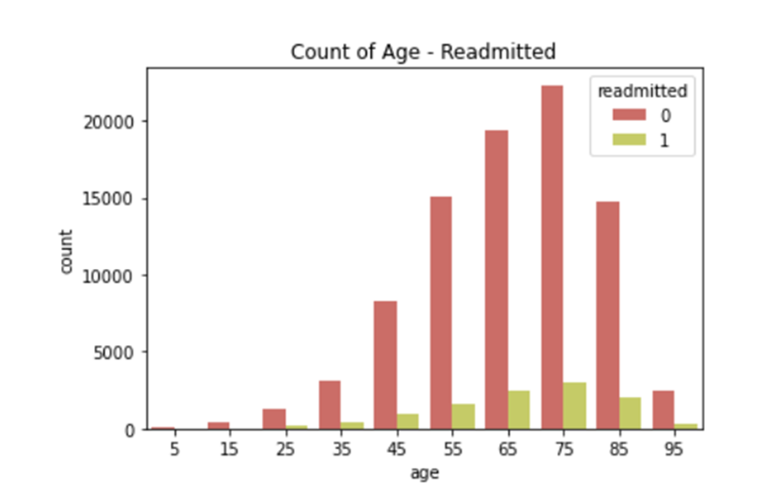
Preprocessing Data
FEATURE ENGINEERING
MULTI-CLASS TARGET VARIABLE TO BINARY
DROPPING NULL VALUES
LABEL ENCODING RACE & GENDER
TRAIN/TEST/SPLIT (test_size = .2)
STANDARD-SCALER TO NORMALIZE DATA
SHUFFLE SPLIT – CROSS VALIDATION
Notes:
Michelle – Here are some preprocessing steps. Just to call out a few of the steps we took, Prior to model development, we did some Feature engineering. We converted the age category from categorical to numeric, using the mean of each bracket. Since age is ordinal, this allows to preserve the information instead of dealing with age as a binary dummy variable.
We also converted our target variable from three values to two binary classes.
Here are additional steps to process the data where dropping null values, label encoding race & gender, train/test/split, and standard-scaler to normalize data for model development.
And we did shuffle split and cross validation, which gave us a better idea of overall model performance over a range of accuracy scores.

Slide 11
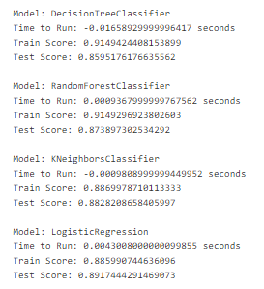
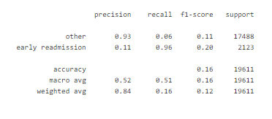
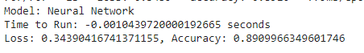
Evaluating Models v.1
1.
2.
HIGH ACCURACY, POOR PERFORMANCE
3.
4.
WINNER
5.
Notes:
Lauren
We evaluated 5 models for our binary classifier - Decision Tree, Random Forrest, K-Nearest Neighbors, Logisitic Regression and a Neural Network model. The best performing model was the Logistic Regression with an accuracy score of 89%. However, when we ran a classification on the model, it was clear that while the accuracy was high, precision and recall were poor across classes.
We hypertuned the model, added and removed features, and eventually came to the conclusion that we needed to address the imbalance in our data.

Slide 12
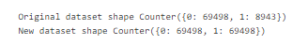
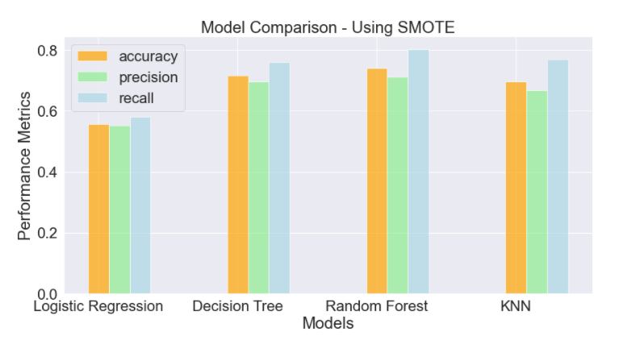
Techniques to Address Imbalance
WINNER
Notes:
Lauren – To address imbalance in our data, we first tried to upsample and downsample the training data. When that did not work, we applied SMOTE. Here you see models that we evaluated after we applied SMOTE, which balances class 0 and 1.
After applying SMOTE, we you can see from the graph that accuracy, precision and recall scores were much better. The best performing model was Random Forest.

Slide 13
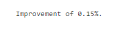
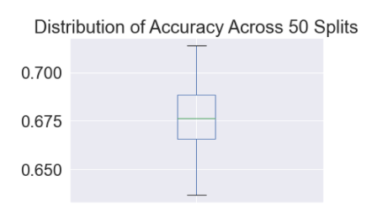
Optimizing the Model
Notes:
Lauren – Once we had the best model, we ran grid search to find optimal parameters. The improvement was minimal at .15%.
In order to know if we really have the best model, we need to look at the distribution of the accuracy measures. This will tell us best case and worst case performance of our model.
https://towardsdatascience.com/hyperparameter-tuning-the-random-forest-in-python-using-scikit-learn-28d2aa77dd74

Slide 14
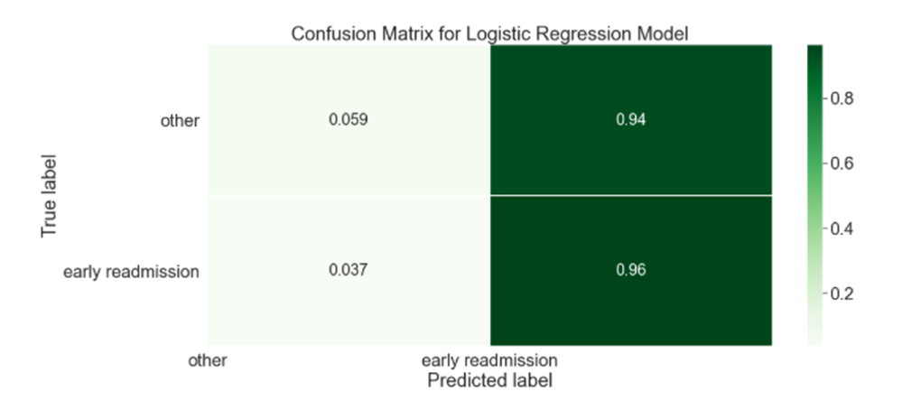
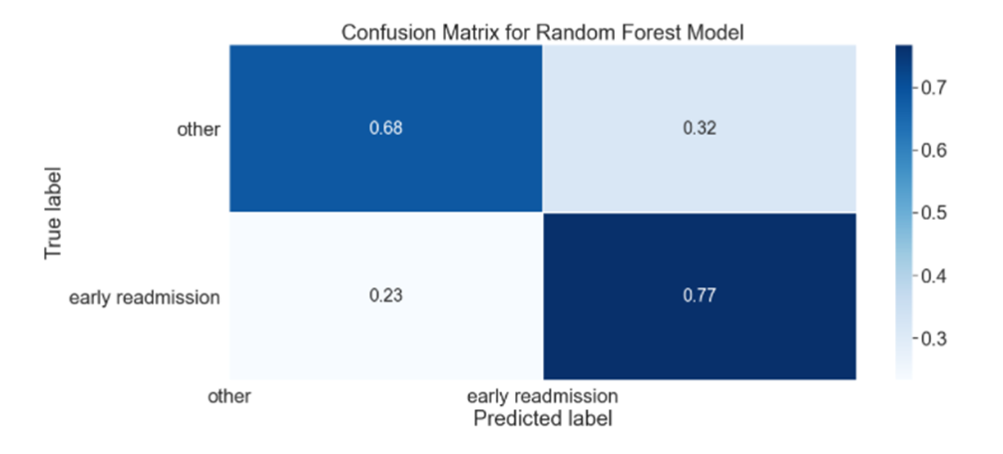
Model Evaluation
TOP Model Pre-SMOTE
TOP MODEL Post - SMOTE
Notes:
Lauren
To further evaluate our model, we looked at the confusion matrix.
The second model, post-SMOTE was much better.

Slide 15
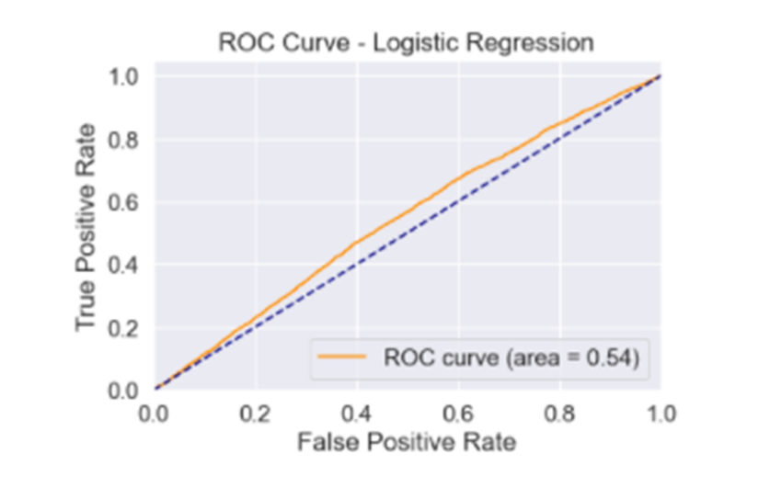
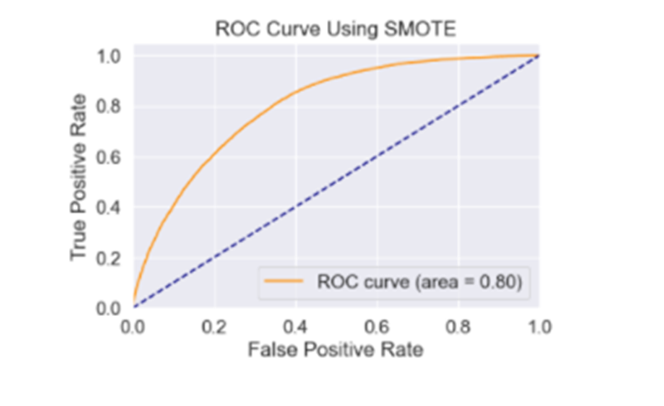
Model Evaluation
TOP MODEL Post - SMOTE​
TOP MODEL Post - SMOTE
Notes:
Lauren -
We also evaluated performance using the ROC curve. You can see that that the visualization on the right is closer to the top-left corner, which indicates better performance, in the trade-off between sensitivity (or TPR) and specificity (1 – FPR). was much better after addressing the imbalance in our data as well.

Slide 16
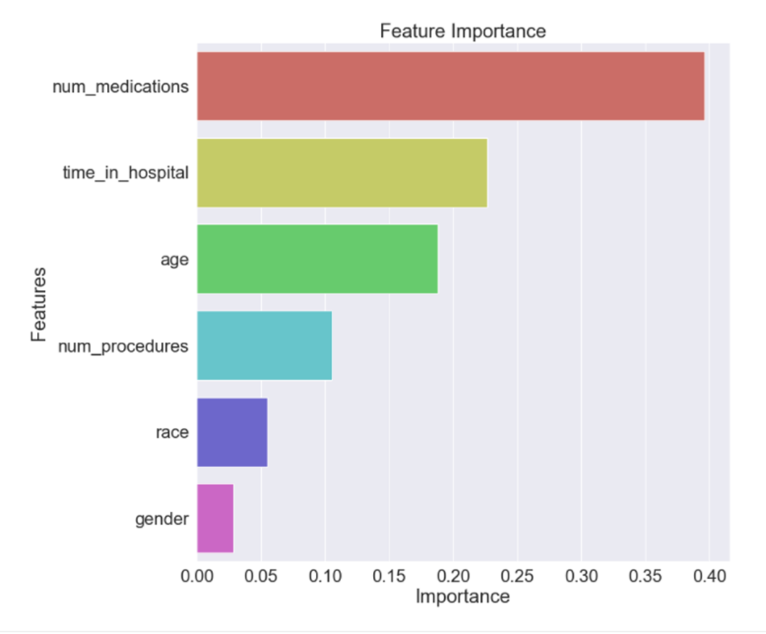
Model Evaluation
Notes:
Lauren - Here you can feature importance in our Random Forest model. Number of medications, time in hospital and age features carry the most importance.

Slide 17
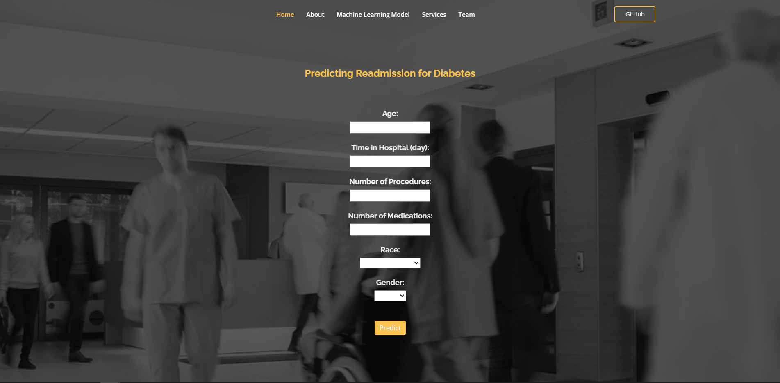

Our Website
SCAN
https://diabetes11.herokuapp.com/
Notes:
Yingying - Thanks Lauren.
Here is a QR code to our website. The link is also available in the chat. Or you can explore the website with me together on the screen!
(Wait 10 second) Are we ready? (Exit the presentation)
In our landing page, we have a form that use our random forest model to predict whether that patient has high or low chance of readmission based on the entered patient information.
To save time, we have prepopulated this set of data.
After clicking on the “Predict” button, the result will be displayed under the button.
To increase the usability of our website, we added four more sections to our website.
(Click on About) In the About section, you can find some background information on diabetes and the benefits of having this model.
(Click on Machine Learning Model) On the top of the Machine Learning Model section, you will find definitions of the features we included in the model. The image here is the importance of the features. Also, you can find some statistics on our model, such as we have 74 percent of accuracy.
(Click on Servies) Also, we thought if we are going to market this website, it will be important to add other things we can do as a business, so we added this services section to highlight what the skills we have, mostly picked up through the bootcamp.
(Click on Team) Last but not least, we have a team section, where our profile pictures are displayed along with our names and job titles. If you hover over, you can access to our github and linkedin profiles by clicking on the icons.
Also, there is github button to our repo.
That will be all for our website. Let me get back to our presentation.
Shift+f5

Slide 18
Next Steps
Our model could help improve quality of life for 10.5% of the US population.
Add feature to save user entered- data to a database to continue to train our model
Control data for bias
- For example, increase data samples from other races
For increased model performance:
- Consider weighting features
- Consider other imbalance-learn techniques like RandomOverSampler and UnderSampling vs. SMOTE
Look at other ML models like AdaBoost or XGBoost
Decode the “black box”
Notes:
Yingying -
So obviously, our model building has its limitation due to time constraint and limited dataset. To make our model more impactful for the 10.5% of the US population that are diagnosed with diabetes. We think we can doing the followings.
(Click) To increase our dataset and also as a way to collect newer data since our data is from 1999 to 2009. We think it will be great to add feature to the website to save user entered-data to database to continue to train our model.
(Click) If you remember, we our dataset has a small percent of Hispanic and Asian population, it’s important to increase those population’s data samples to avoid any bias due to sample size limitation.
(Click) Last but not least, we can continue to improve our model accuracy by trying following methods. Such as weighting features, using other other imbalance-learn techniques like RandomOverSampler and UnderSampling, or test other ML models like AdaBoost or XGBoost.
(Click) Right now, we don’t provide any suggestion on what to do with the prediction and the model feels like a black box. In the future we plan on providing more background information to help lay people to understand the model and how to utilize the predicted results.

Slide 19

Q&A
Notes:
Yingying – Thank you for joining us in this presentation! We hope you have enjoyed it. Now it’s time for any questions or comments.

Slide 20
Appendix

Slide 21
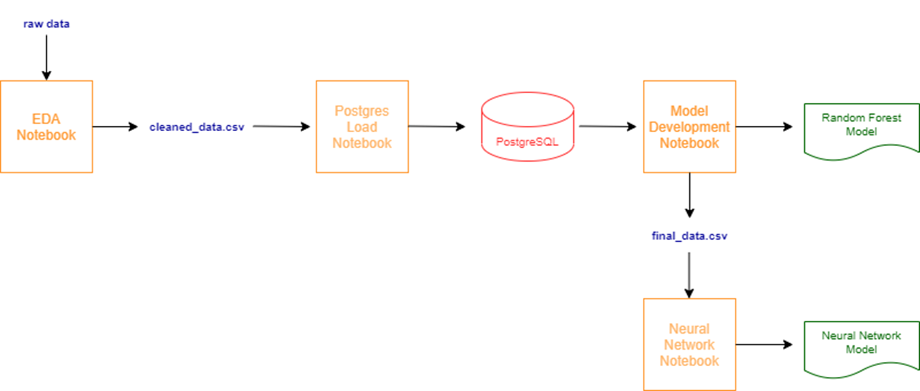
Process Flow - Github
Notes:
For github clarity

